Slide 1
Decoupling Representation and Classifier
李晓宇
2020.11.19

Slide 2
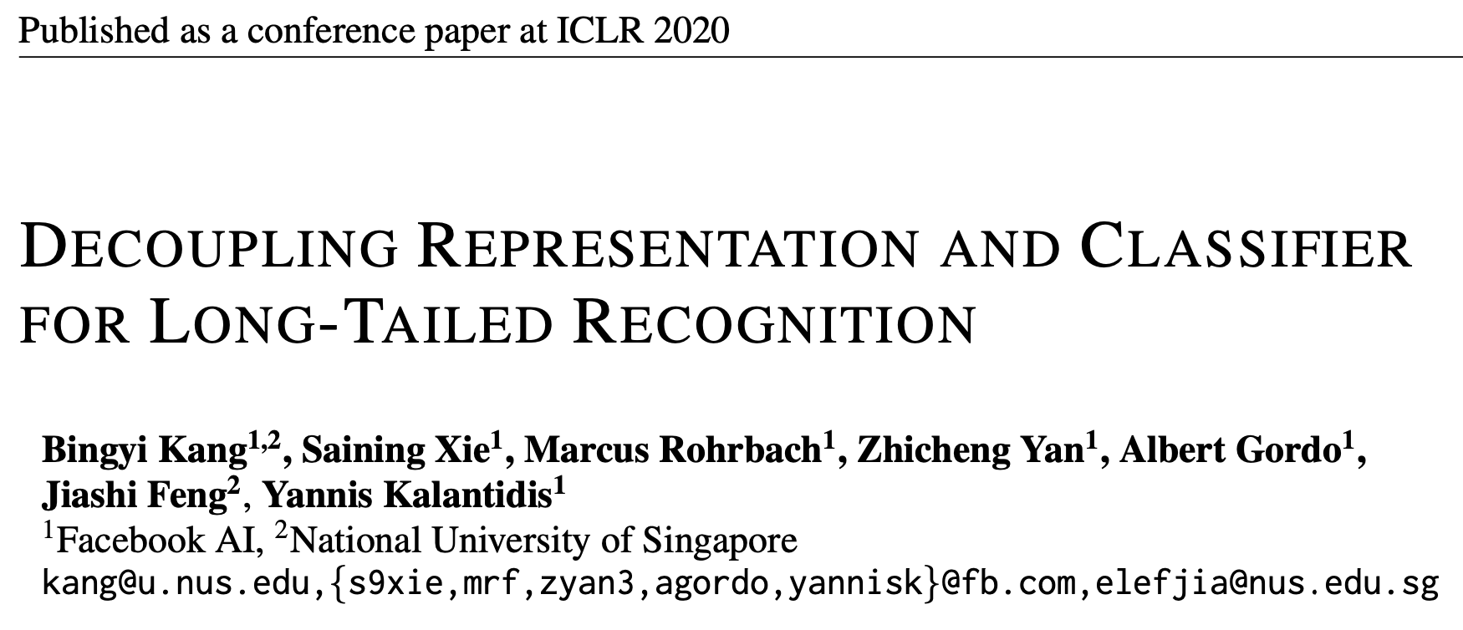

Slide 3
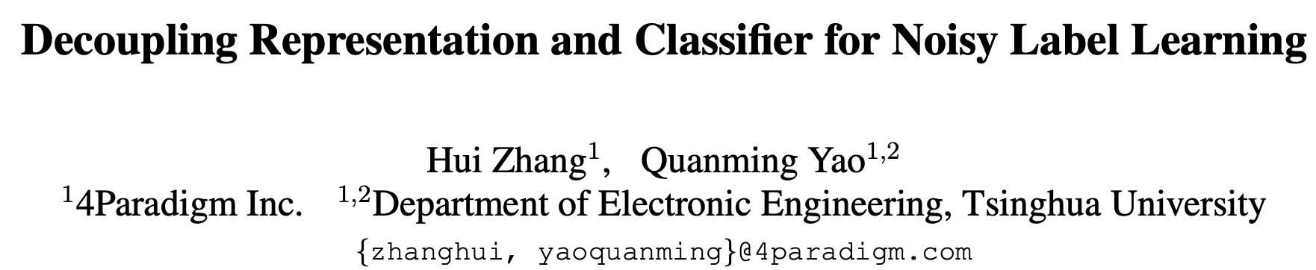

Slide 4








DECOUPLING REPRESENTATION AND CLASSIFIER FOR LONG-TAILED RECOGNITION
Notation:
x
Deep CNN f
*
z
Representation
Classifier

Slide 5
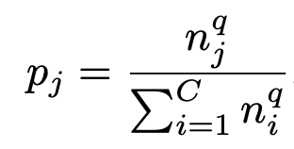

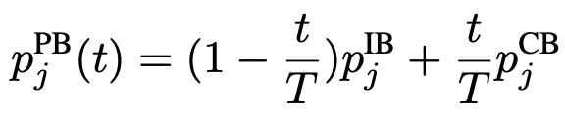
Sampling Strategies
The probability pj of sampling a data point from class j :
Instance-balanced sampling. q=1
Class-balanced sampling. q=0
Square-root sampling. q=1/2
Progressively-balanced sampling

Slide 6
Classification for long-tailed recognitions
To consider decoupling the representation from the classification in long-tailed recognition
Jointly train
Classifier Re-training (cRT)
Keeping the representations fixed, we randomly re-initialize and optimize the classifier weights W and b for a small number of epochs
Nearest Class Mean classifier (NCM)
To first compute the mean feature representation for each class on the training set and then perform nearest neighbor search either using cosine similarity or the Euclidean distance computed on L2 normalized mean features
τ-normalized classifier (τ-normalized)
Learnable weight scaling (LWS)

Slide 7
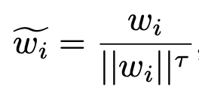
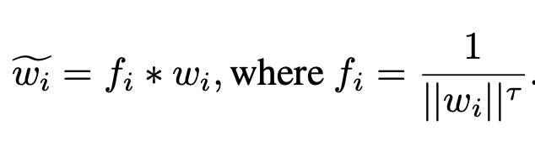
τ-normalized classifier & Learnable weight scaling
After joint training with instance-balanced sampling, the norms of the weights ||w_{j} || are correlated with the
cardinality of the classes n_{j}, while, after fine-tuning the classifiers using class-balanced sampling, the norms of
the classifier weights tend to be more similar
τ-normalized classifier (τ-normalized)
x
Deep CNN f
*
z
Learnable weight scaling(LWS):

Slide 8
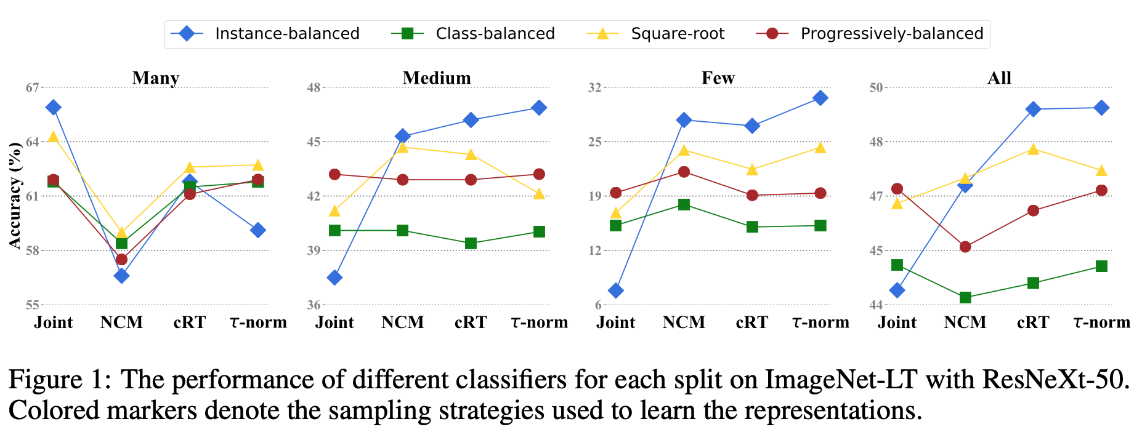
Experiments
Many-shot (more than 100 images)
Medium-shot (20∼100 images)
Few-shot (less than 20 images)
All
Sampling matters when training jointly
Joint VS decoupled learning
Instance-balanced sampling gives the most generalizable representations

Slide 9
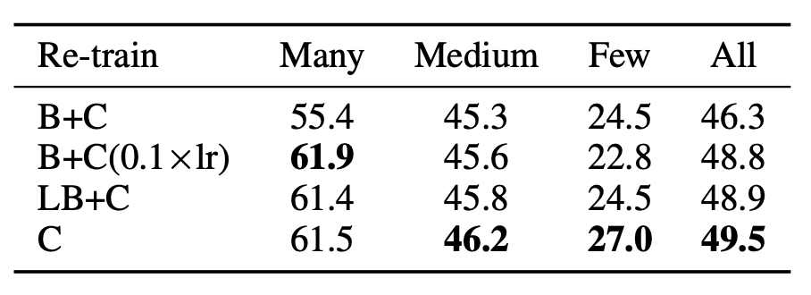
Experiments - Joint VS decoupled learning
Note: It is yet still somehow surprising that both the NCM and τ -normalized cases give competitive performance even though they are free of additional training and involve no additional sampling procedure.

Slide 10
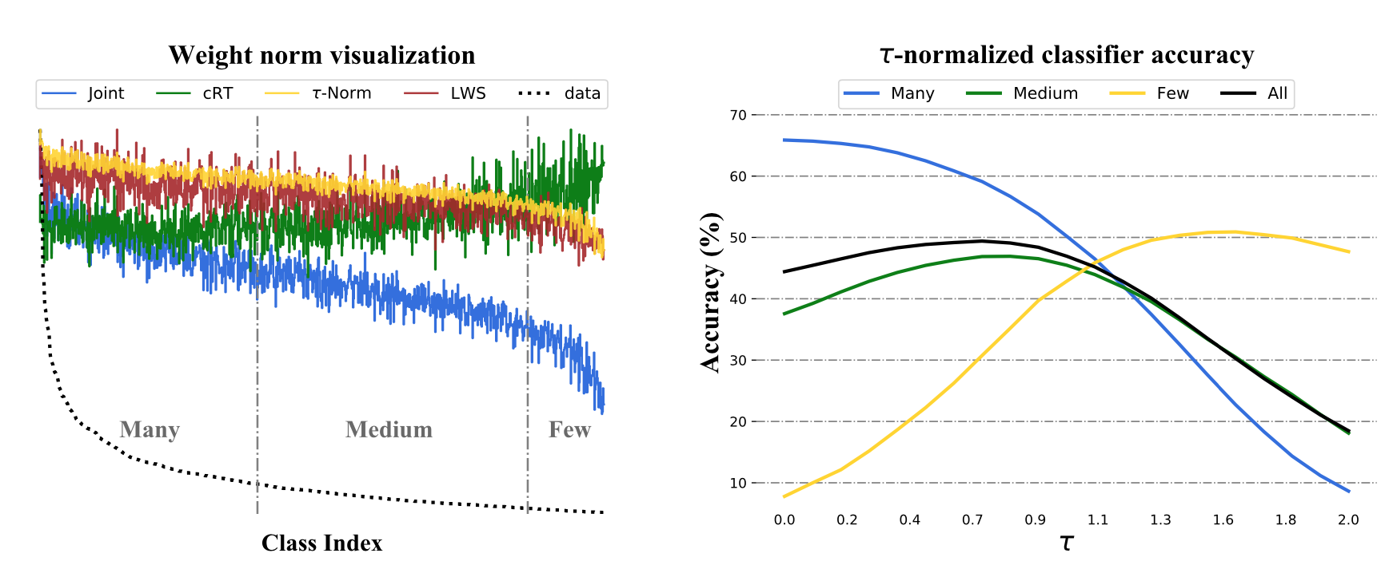
Experiments

Slide 11
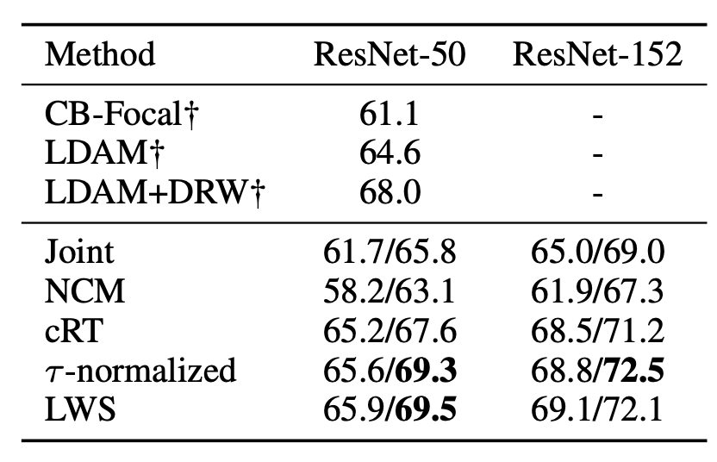
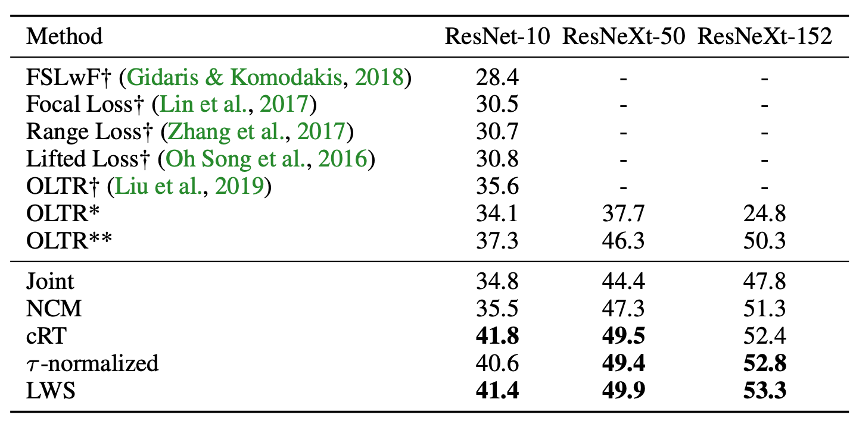
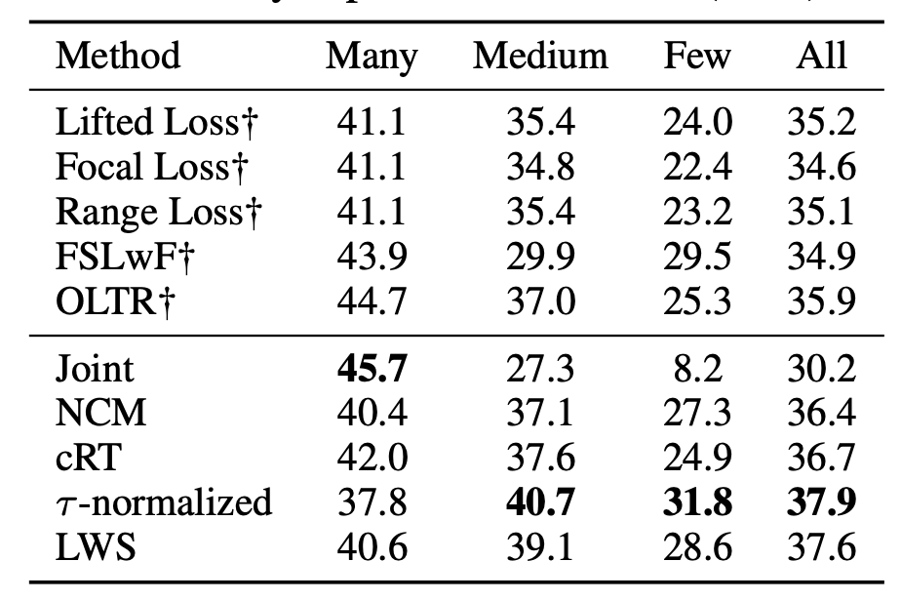
Experiments

Slide 12
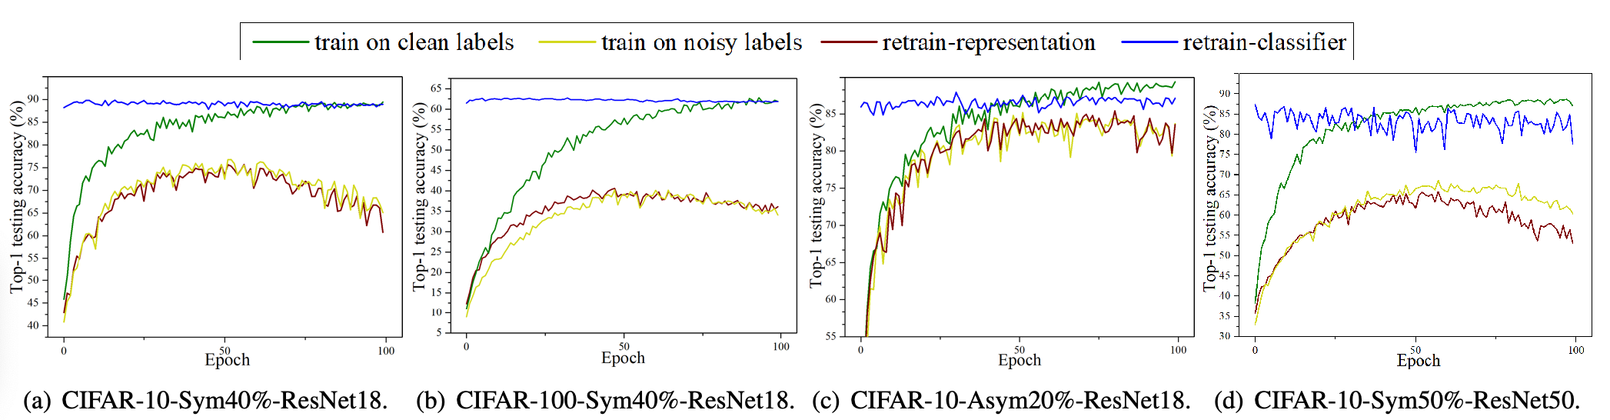
Decoupling Representation and Classifier for Noisy Label Learning
We first train the whole ConvNet with clean labels (see the curve train on clean labels).
We retrain the representation with noisy labels while fixed the classifier inherited from the ground-truth model (i.e., retrain-representation)
and retrain the classifier with noisy labels while fixed the representation inherited from the ground-truth model (i.e., retrain-classifier)
Finally, we include the baseline training the whole network with noisy labels in an end-to-end manner (i.e., train on noisy labels)

Slide 13
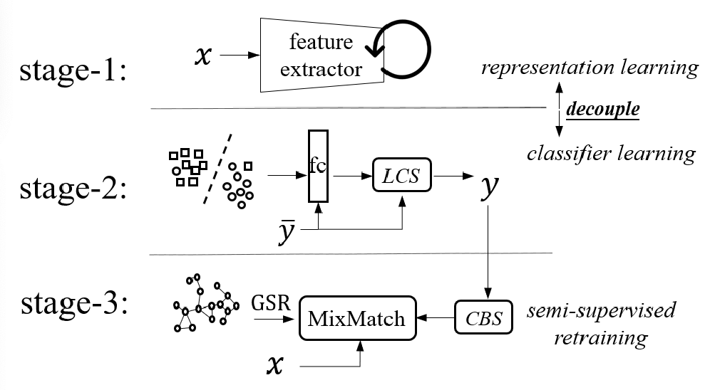
Method REED
Self-Supervised Representation Learning
Divide data to labeled set and unlabeled
set with threshold during training
Semi-supervised learning

Slide 14
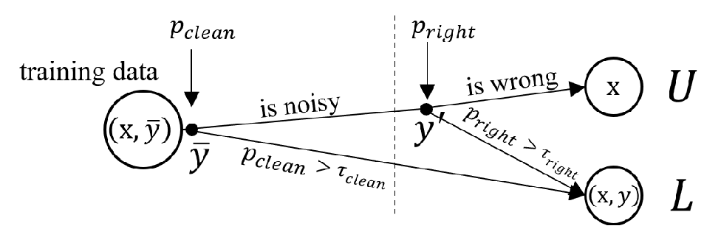
Stage 2
Label credibility assessment module: transferring noisy labels into clean or unknown labels.
If clean
assign sample to L;
Else:
if predict with high confidence:
assign sample to L;
else:
assign sample to U;
P_{clean}? Two-component GMM on L_{CE} distribution from DivideMix
P_{right}? “samples with highly confident predictions tend to be
correctly classified”GMM on p_{i}

Slide 15
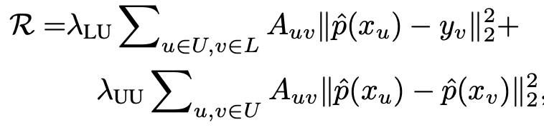

Stage 3
Graph-structured regularization
to utilize the similarity of learned representation from stage1
Class-balanced sampler
To make L balanced: sampling probability Pi = 1/C for the i_{th} class
To make U balanced: to take all x in the original dataset as candidates

Slide 16
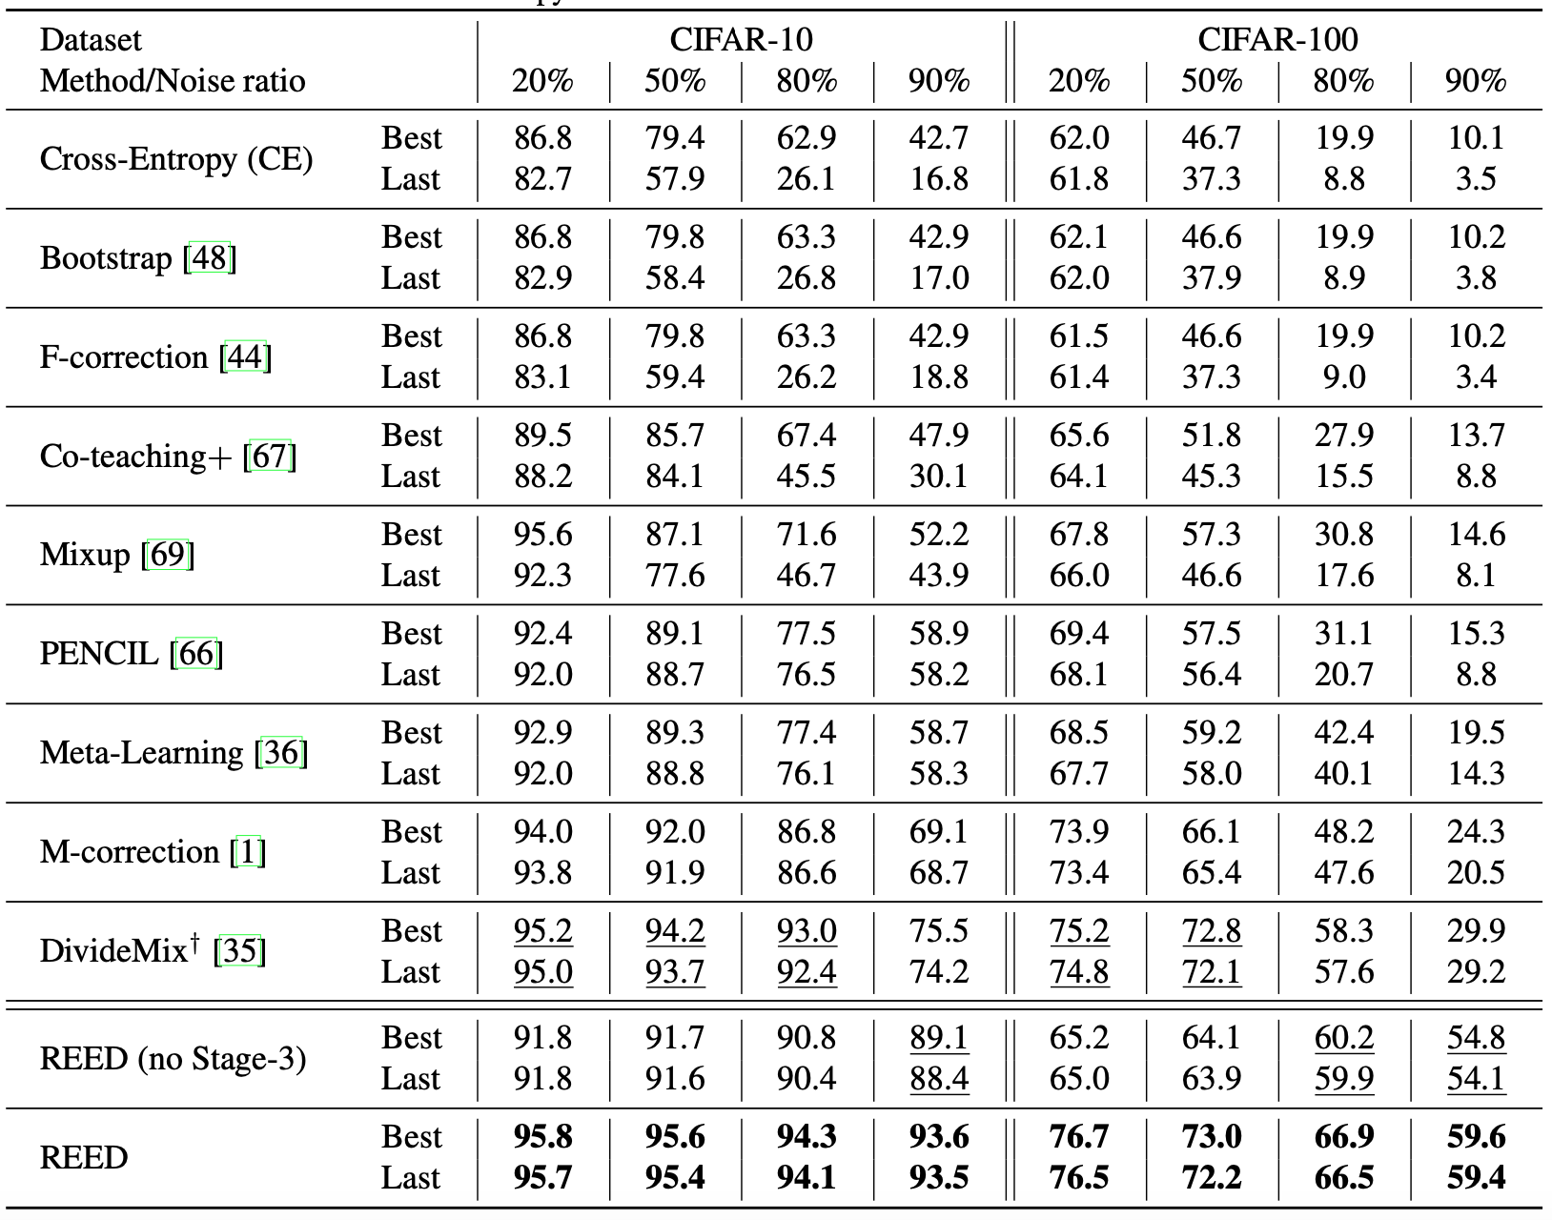
Experiments

Slide 17
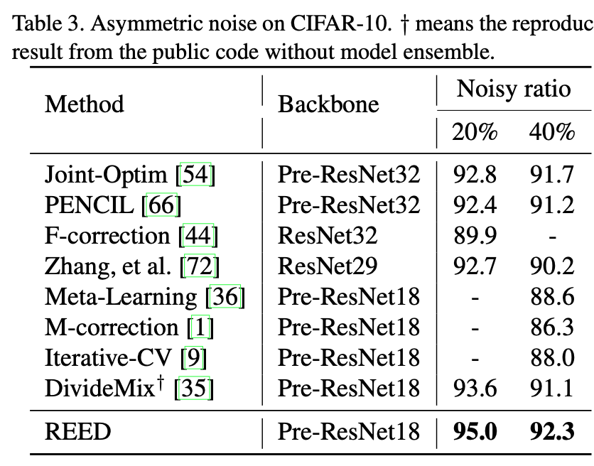
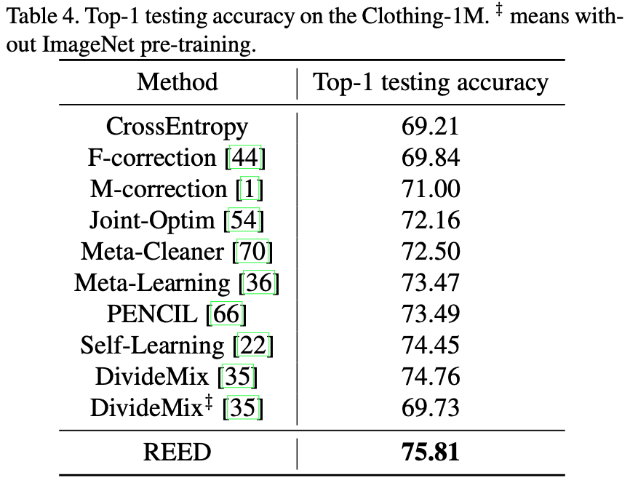
Experiments

Slide 18
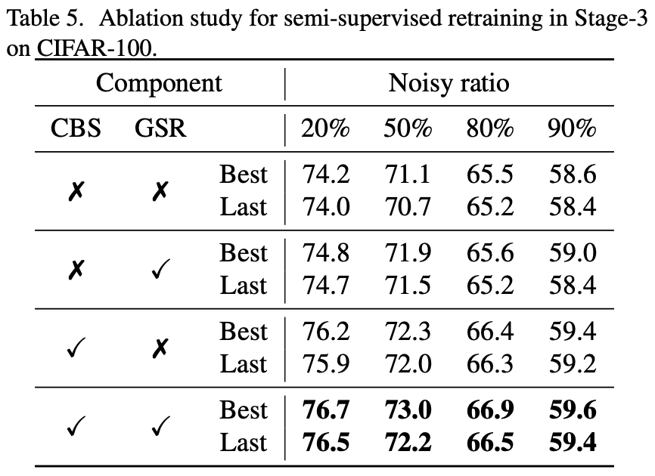
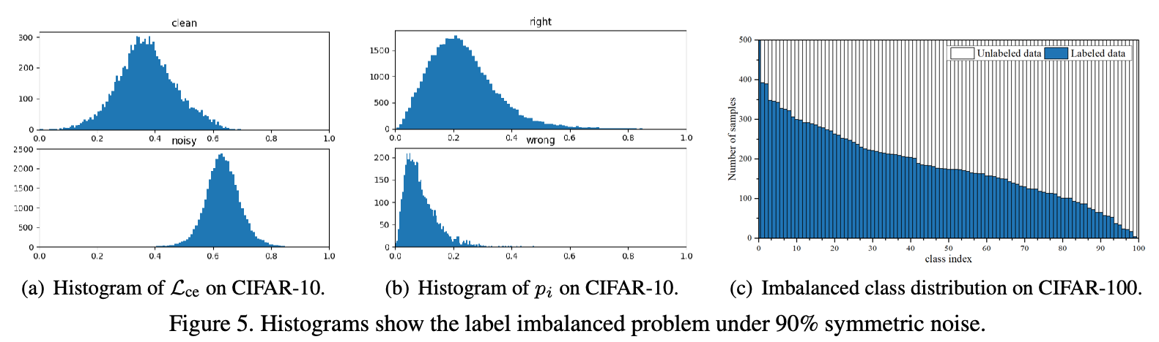
Experiments

Slide 19
Thanks
Q&A

